Slide 1
Parental Survey St Mary’s C of E Primary School
2021

Slide 2
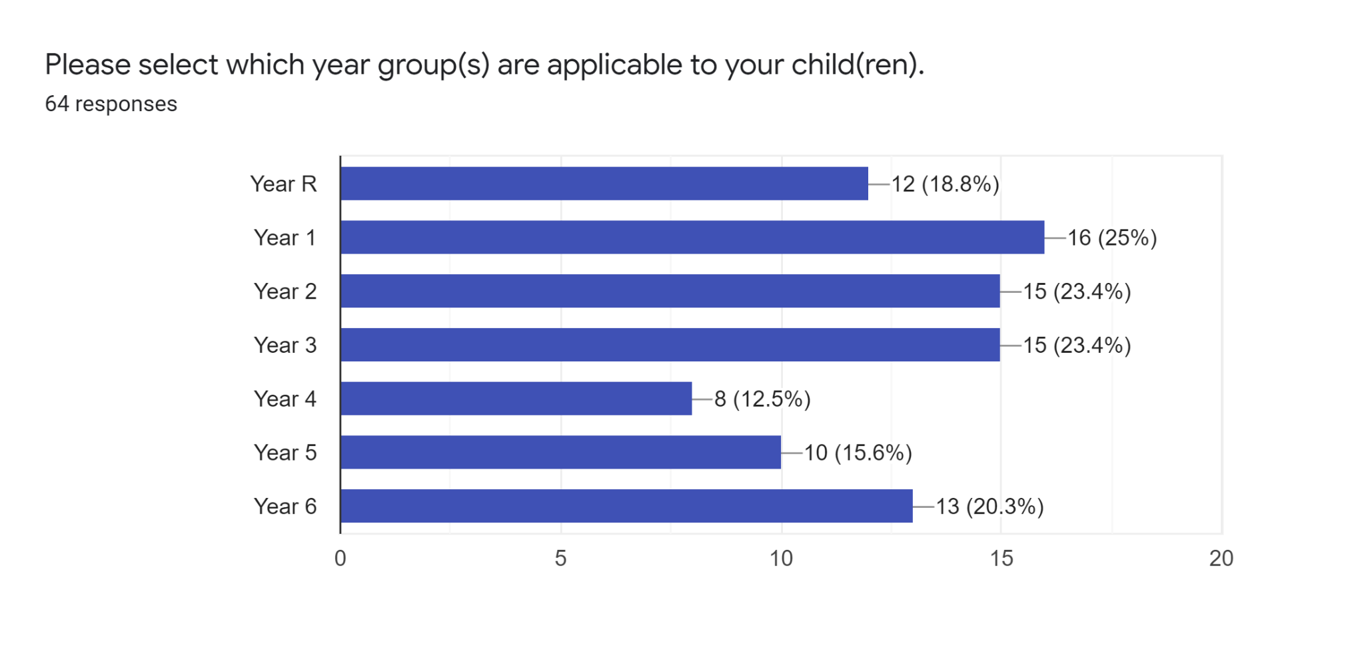
Which parents participated?
parental responses were received.
Parents from every year group responded.

Slide 3
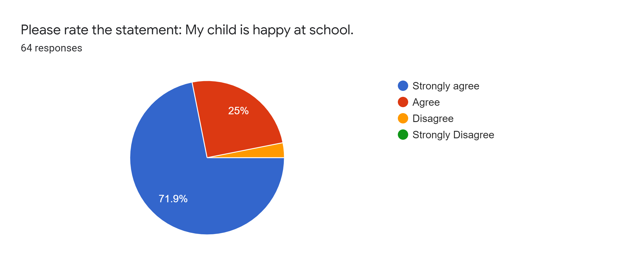
Please rate the statement:
My child is happy at school.

Slide 4
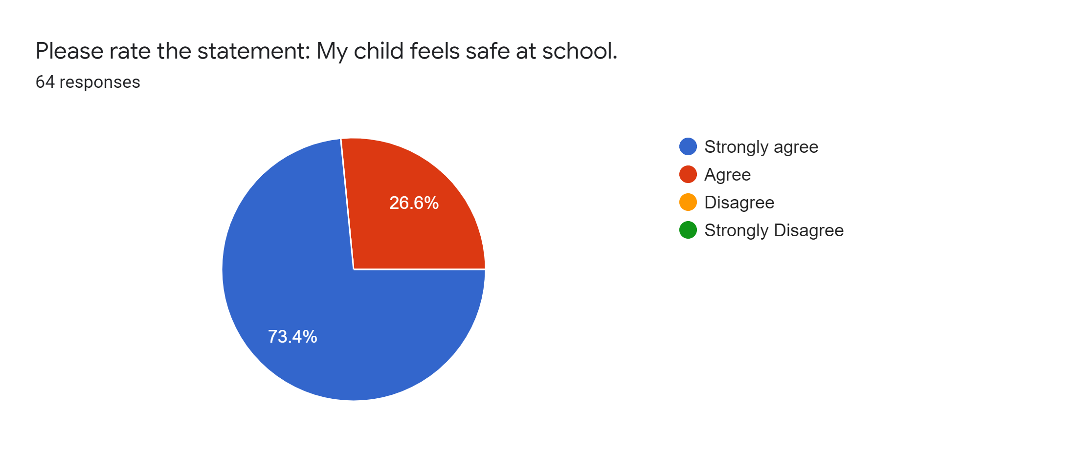
Please rate the statement:
My child feels safe at school.

Slide 5
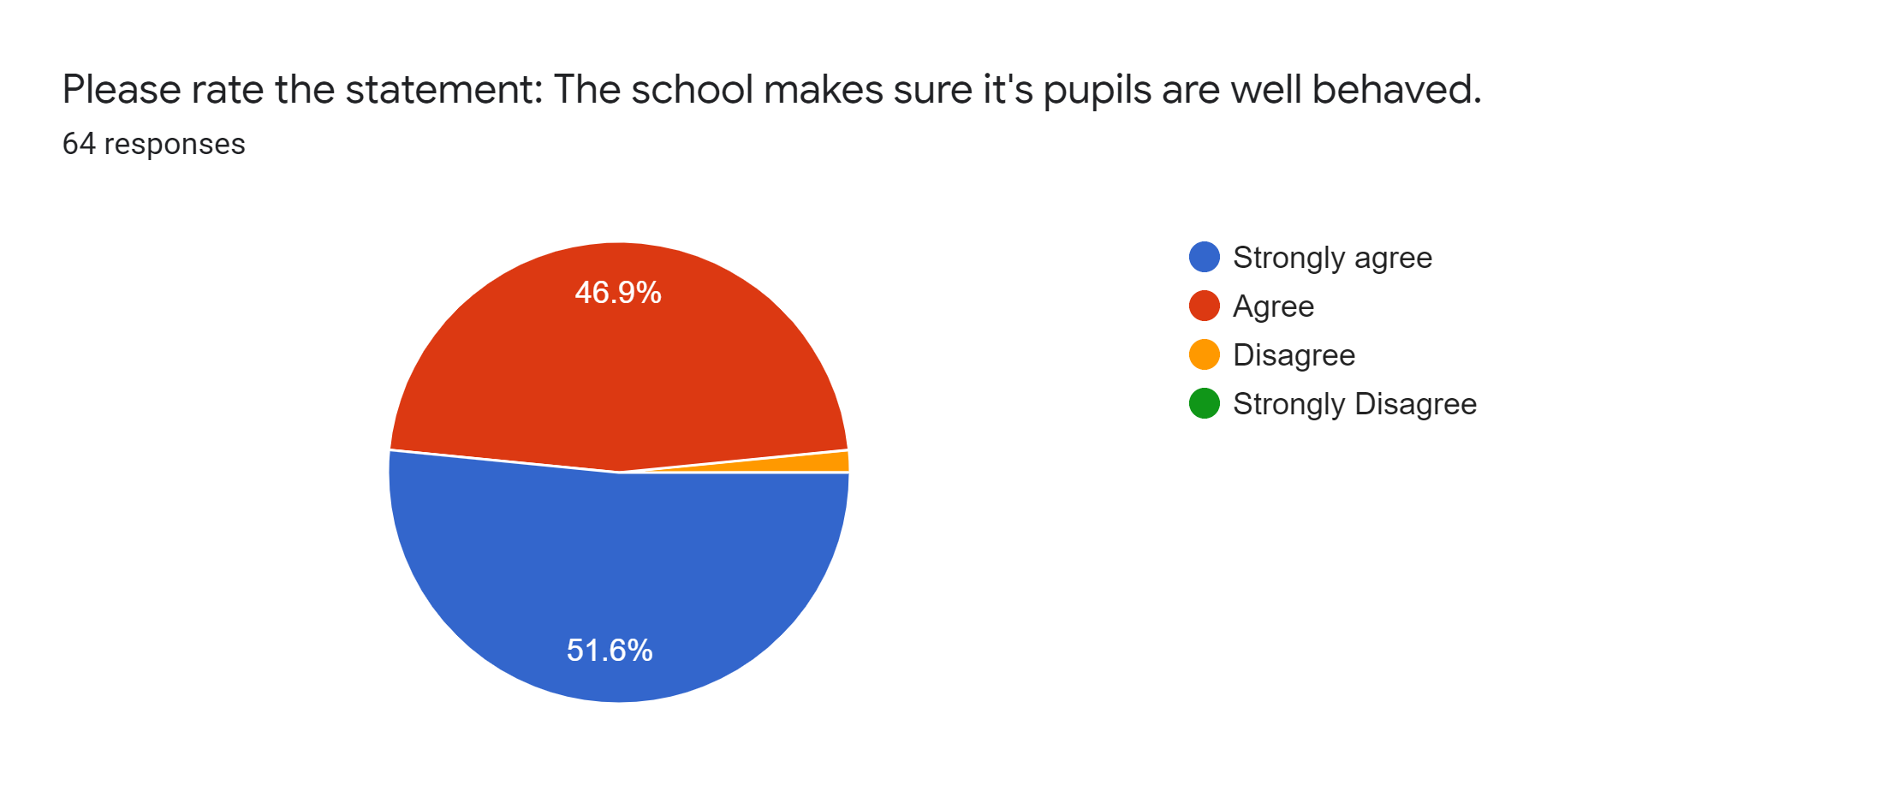
Please rate the statement:
The school makes sure its pupils are well behaved.

Slide 6
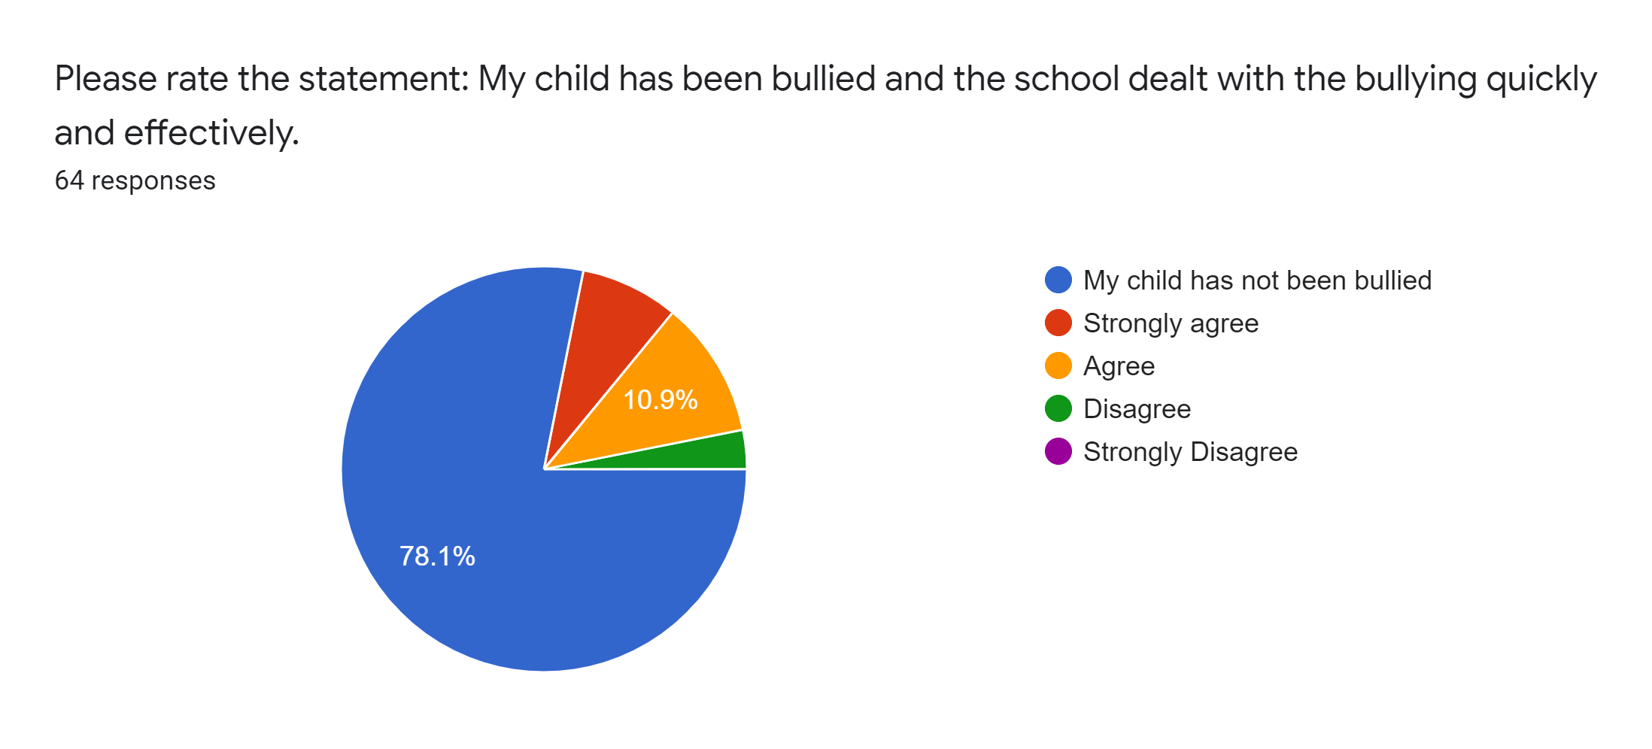
Please rate the statement:
My child has been bullied and the school dealt with the bullying quickly and effectively.

Slide 7
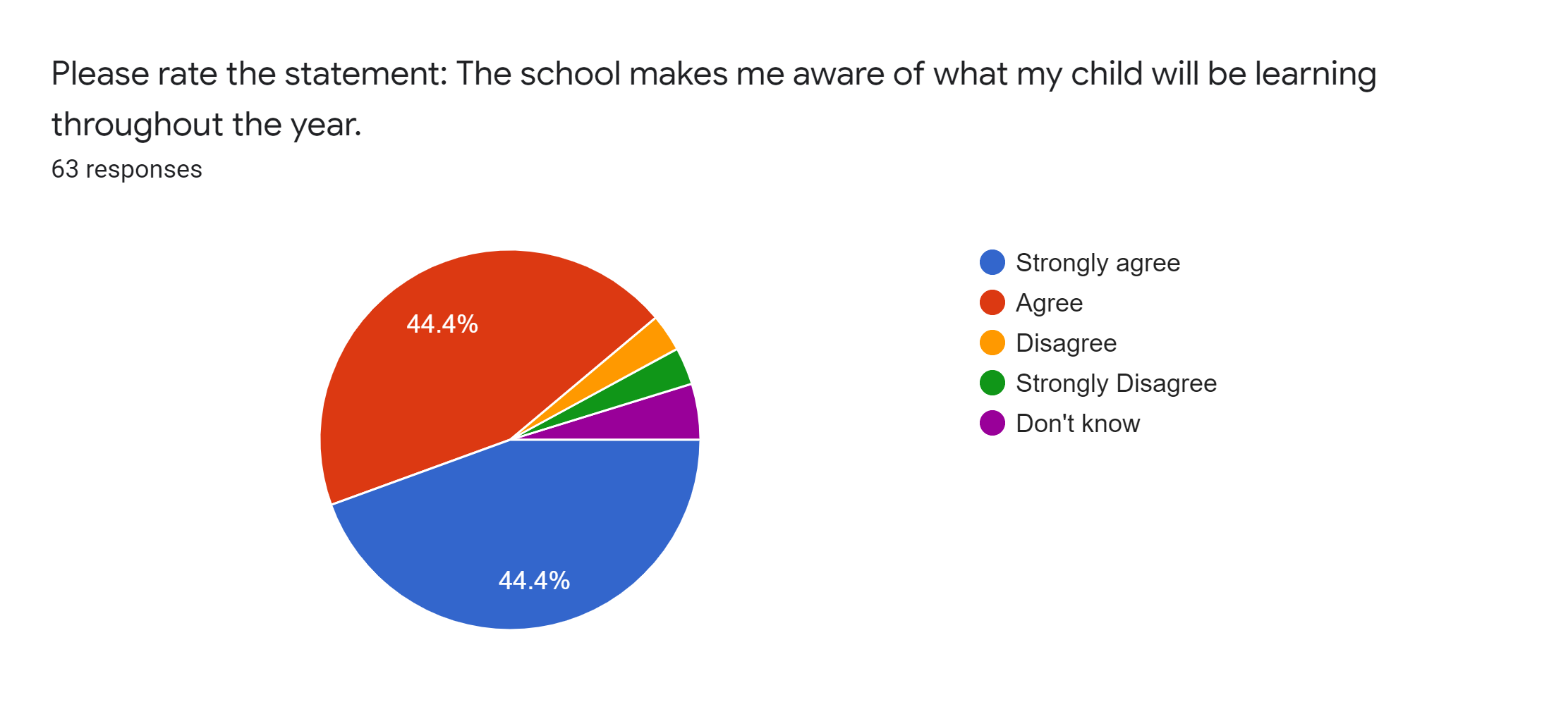
Please rate the statement:
The school makes me aware of what my child will be learning throughout the year.

Slide 8
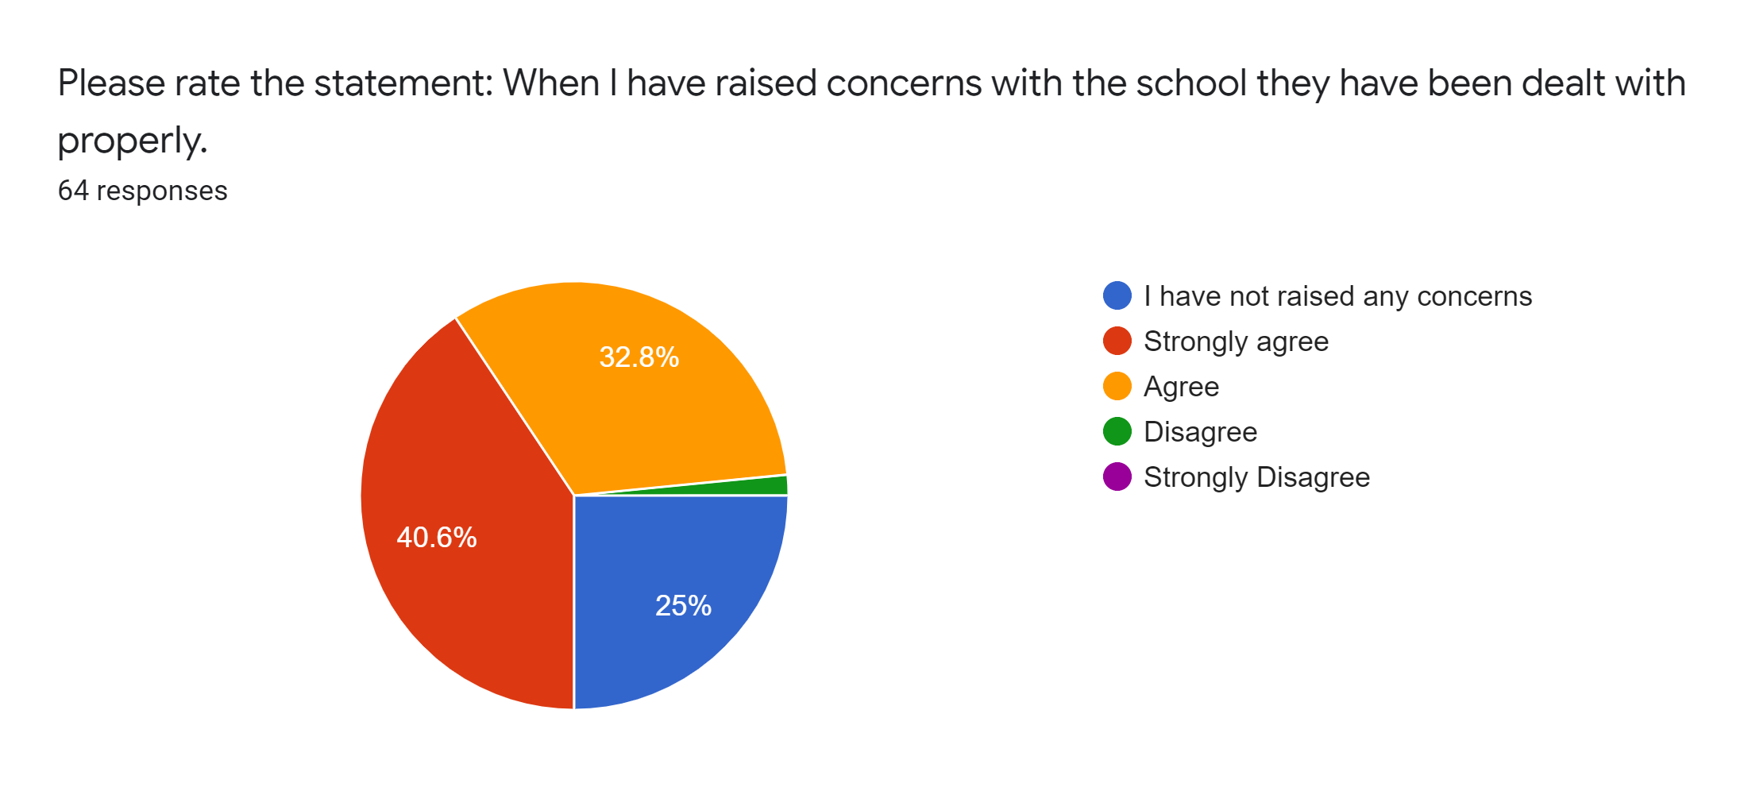
Please rate the statement:
When I have raised concerns with the school they have been dealt with properly.

Slide 9
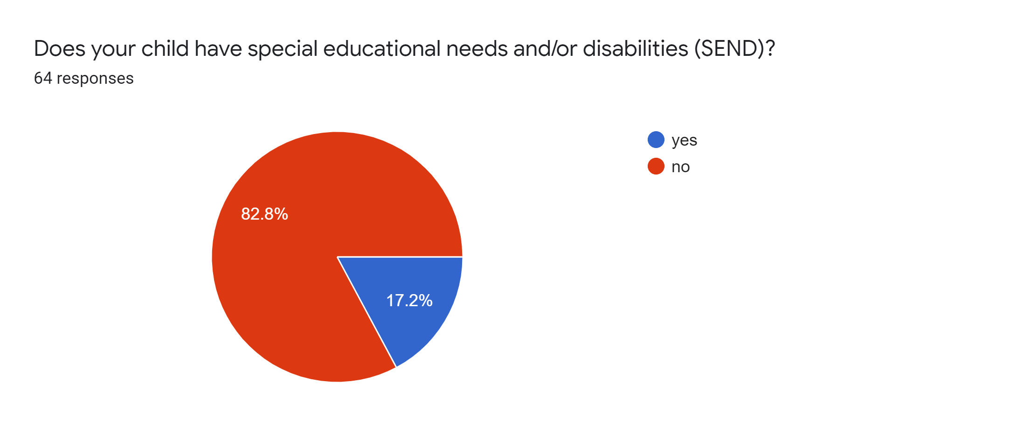
Please answer, yes or no:
Does your child have special educational needs and/or disabilities (SEND)?

Slide 10
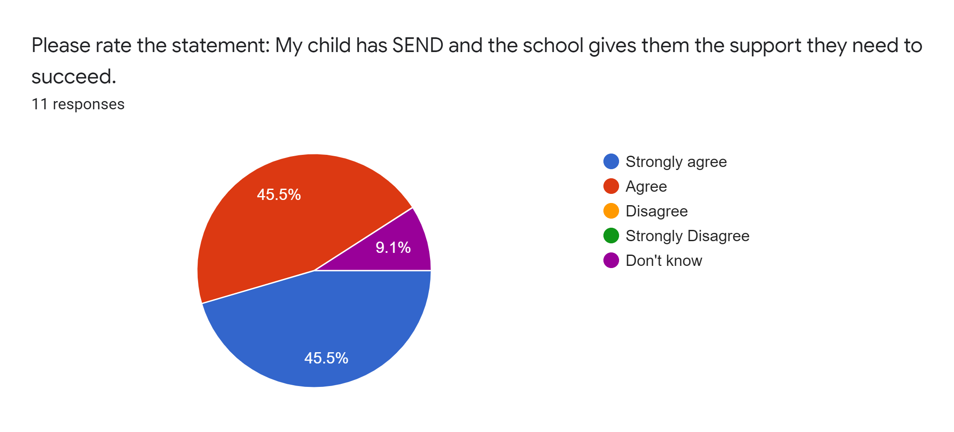
Please rate the statement:
My child has SEND and the school gives them the support they need to succeed.

Slide 11
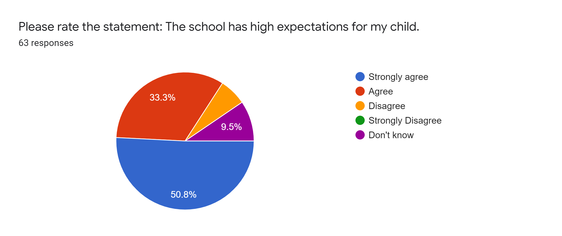
Please rate the statement:
The school has high expectations for my child.

Slide 12
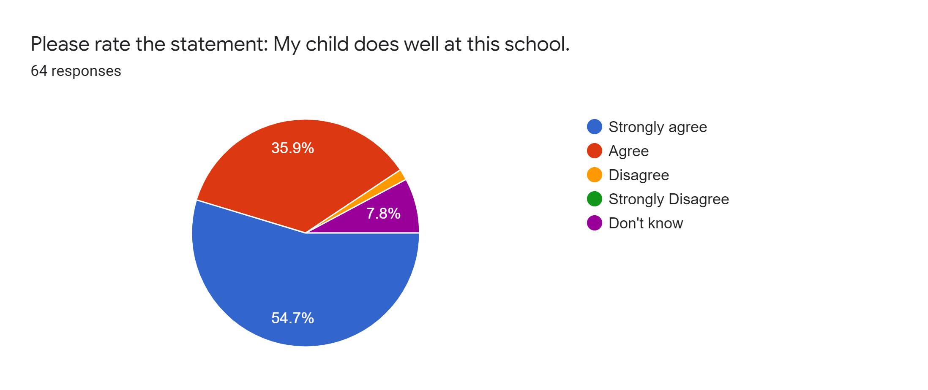
Please rate the statement:
My child does well at this school.

Slide 13
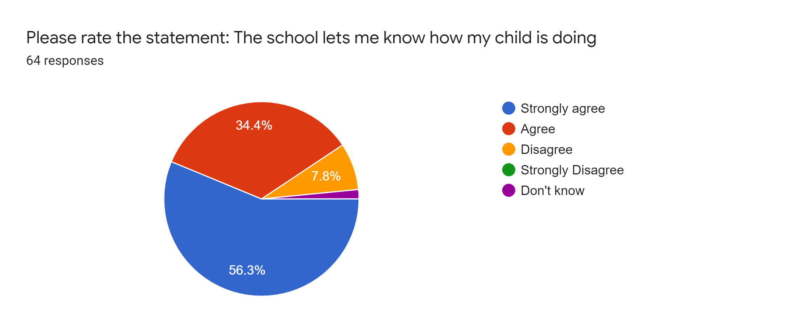
Please rate the statement:
The school lets me know how my child is doing.

Slide 14
Please rate the statement:
There is a good range of subjects available at this school.

Slide 15
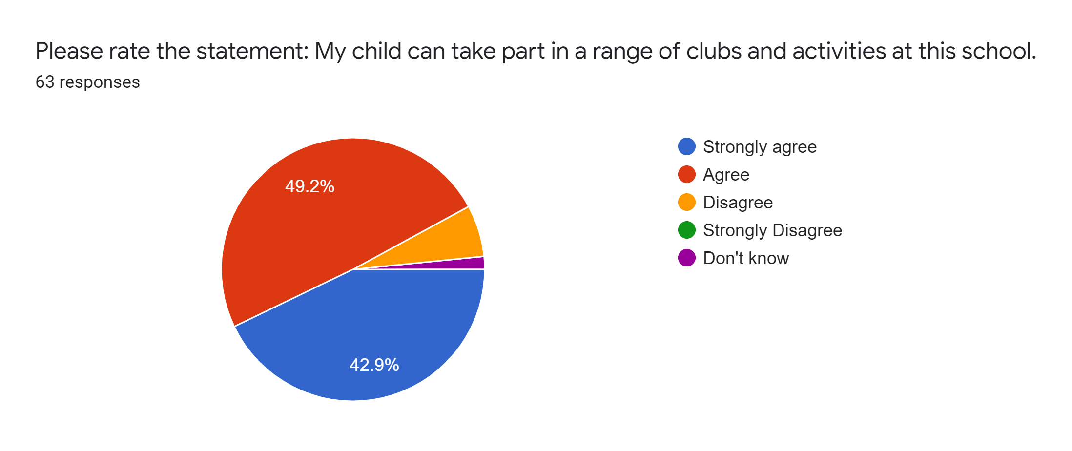
Please rate the statement:
My child can take part in a range of clubs and activities at this school.

Slide 16
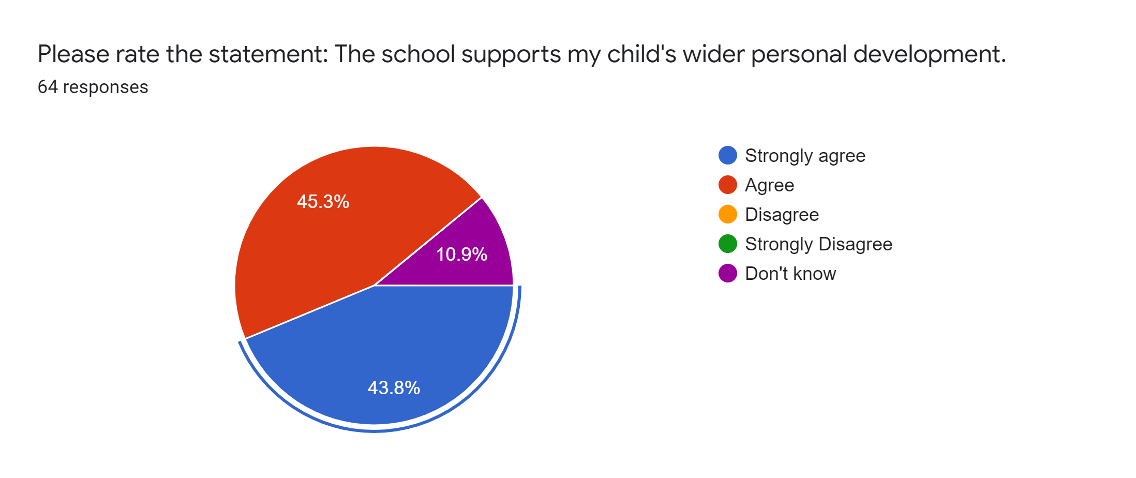
Please rate the statement:
The school supports my child’s wider personal development.

Slide 17
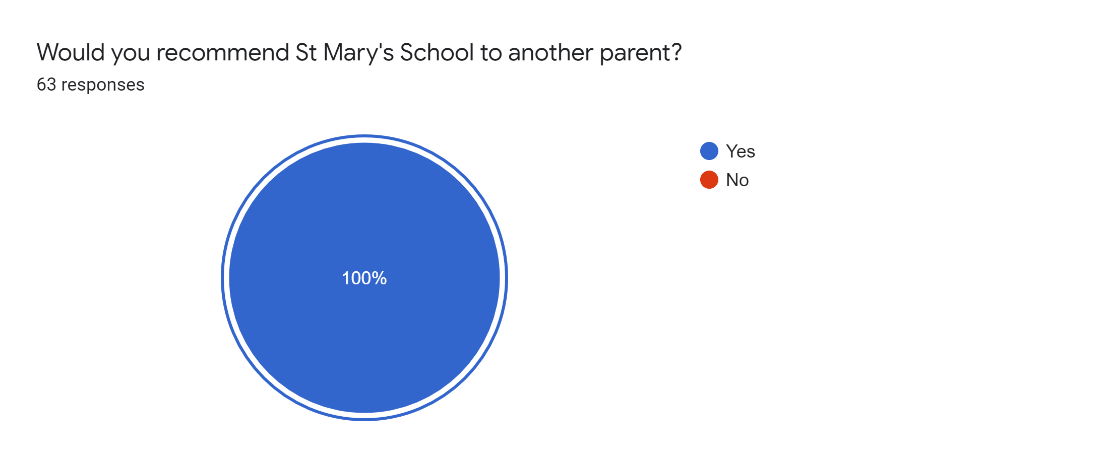
Please answer, yes or no:
Would you recommend St Mary’s School to another parent?

